Slide 1
Building a Portfolio of K-12 Outreach
Nancy Moyers and Ashley Augustine

Slide 2
Why Target K-12?
Create a pipeline
Fosters an interest
Provides Resources
Leads to STEM careers
Meets STARS goal
Notes:
- Used to build networks and gain connections

Slide 3
How we do it
Normally
Hard to get going
Lack of coordination
No communication
Notes:
- Used to build networks and gain connections

Slide 4
How we do it
Our approach
Leadership support
Financial support
Student Initiated
Reputation
Notes:
- Used to build networks and gain connections

Slide 5
How do you get that level of trust?
Showing Success
Teacher feedback
Documentation
Ongoing relationships

Slide 6
Get Involved
You have to get involved and get the experience in order to build support.

Slide 7
Forms of Outreach
Visits
Hosting
Local
Out of Town
Work with Teachers

Slide 8
Your K-12 Portfolio
Plan
Presentation
Progress
Notes:
- Used to build networks and gain connections

Slide 9
Set an Expectation
What is Your…
Goal (SMART!)
Focus
Motivation (food!)
Notes:
- Used to build networks and gain connections

Slide 10
Assemble a Team
Outreach is a team sport. Find like minded individuals who’d be glad to help and team up.
STARS + other FSU students + businesses
Notes:
- Used to build networks and gain connections

Slide 11
Team Work
Success depends on the team
Specify roles and expectations
Set DEADLINES!
Frequent meetings

Slide 12
Team Meetings
Plan points of discussion
Review last mtg notes
Make mtg notes accessible to members
Virtual mtgs (groupme, google hangouts, skype)

Slide 13
Teacher Contact
First thing you do
Direct communication
Get past the office
Stick with what works

Slide 14
Do Your Research
Special Program
Gifted, IB, etc.
Clubs of Interest
TSA, FBLA, etc
Award & Achievements
STEM focus

Slide 15
The Pitch
Make your intentions clear
Give a general overview of what your presentation will consist of
WIFM (teacher)

Slide 16
Suggest Activities
Have a game plan
Do your homework!
What will help drive the point of the presentation
Teachers offer great suggestions

Slide 17
Know Your Resources
Create a balanced ratio
Have reinforcements ready
You can never have too much help

Slide 18
Assess the Audience
Different age group/ Different approach
Tailor your presentation to match their interest (curriculum)

Slide 20
Be Well Rehearsed
Pay more attention
Easier to understand
Be Confident
“Translational Approach”

Slide 21
Show Enthusiasm
Delivery is everything
They won’t get excited if you don’t
Don’t forget to smile

Slide 22
Build a Connection
Don’t forget to relate to the students
Be open, friendly, inviting so they will be more receptive

Slide 23
Breaking the Ice
Low impact/ little moving
Initiates interaction
Don’t forget to join in on the fun

Slide 24
Share Your Experiences
Q&A
Encourage & Motivate
Give advice you wish you had at their age

Slide 25
Have a Plan B
Roadblocks happen
Don’t stop for too long
Keep presenting
Use a game or activity to fill the time

Slide 26
Collect Feedback
Ask teachers and students
Quiz/Survey
Leave teacher with sponsor information to send feedback to

Slide 27
Quiz/Survey
Administer before & after
Short, Sweet, To the Point
Great way to find out what type of impact you had

Slide 28
Quiz/Survey Details
Info from presentation
What they learned
Favorite Part
Possible Improvements

Slide 29
Say Cheese!
Take photos of your presentation (WITH PERMISSION!)
Best proof
Great marketing tool

Slide 30
Give & Take
Leave them with more information
Explore on their own
Easy to read/navigate through

Slide 31
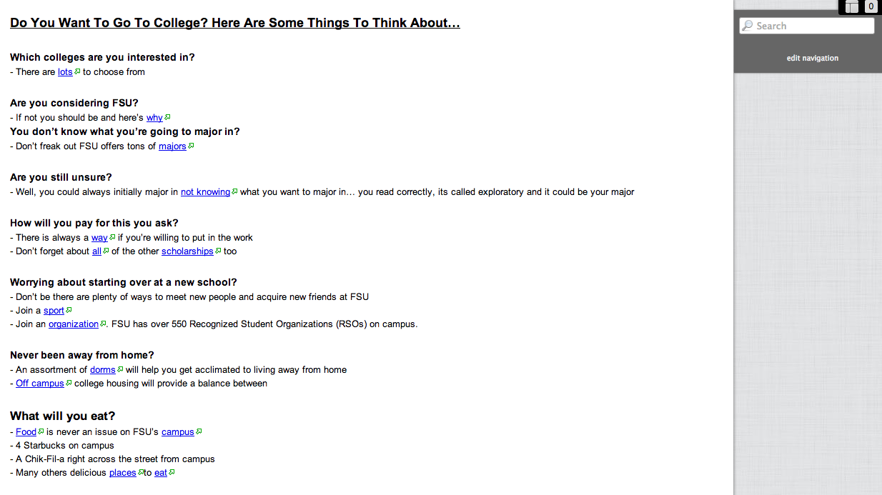
HIGH SCHOOL

Slide 32
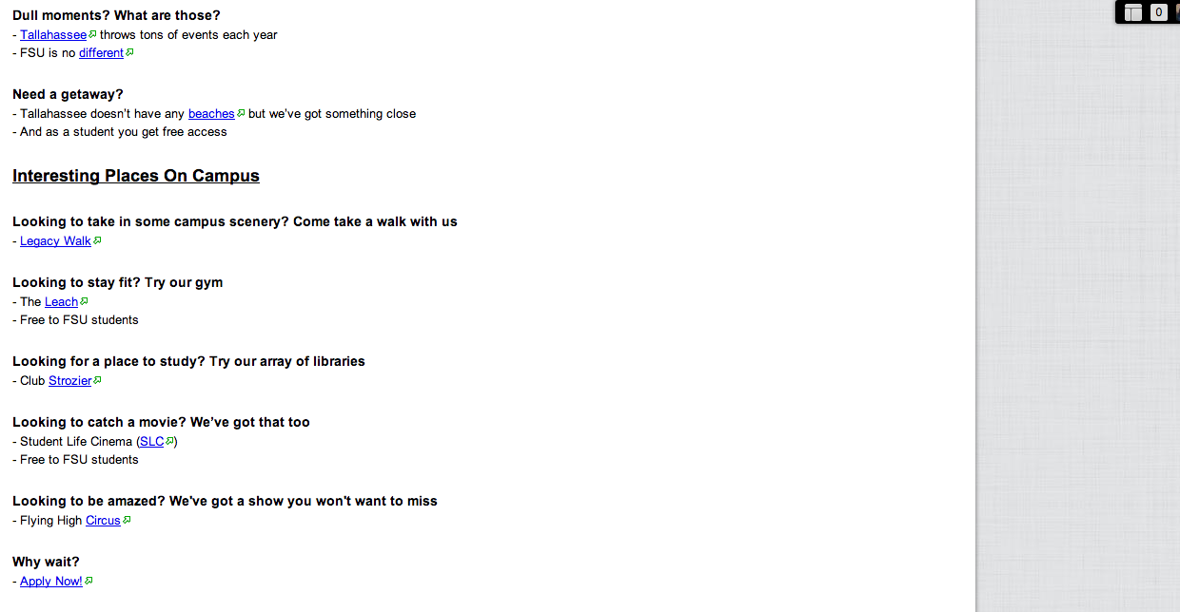
HIGH SCHOOL

Slide 33
Farewell
Express a desire for further interaction
Thank everyone for having you
Follow up with Teacher!

Slide 34
Our Outreach
Snapshot of what we do

Slide 35
Creating A Pipeline
Elementary
4 STEM Clubs
Middle
Camps
High
Visit Schools in Florida
Work with Teachers
Gifted Network!
TSA
Host Schools
TSA
Visit Schools in County
Visit Schools in County
Visit Schools in Florida
Visit Schools

Slide 36
Elementary School Outreach
Targeting kids early

Slide 37
STEM Clubs
Chaires ES/Hawks Rise ES
Go to schools
Work with teachers
Visit regularly
3 year relationship

Slide 38
Topics
Robotics
Powerpoint
Garage Band
Hardware/Software
Future Technology
Photoshop
Edmodo (web design)

Slide 39
Challenges
Traveling to schools
Limited time
Limited Technology
Short Attention Spans
Teacher expectations
Must change every year – avoid repeat activities
STARS turnover!

Slide 40
Example
Video!

Slide 41
Middle School Outreach
The critical formative years

Slide 42
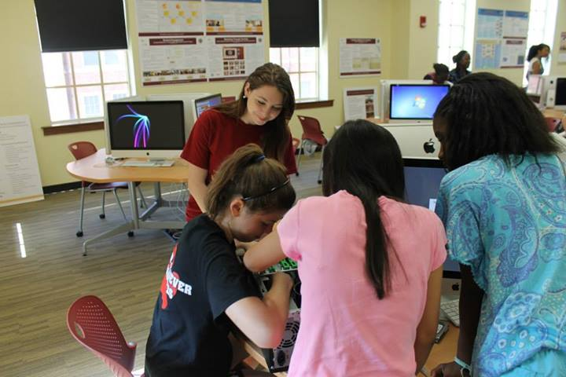

Slide 43
Camps
Bring students to your school to learn new skills
Coding (2 intro camps)
Robotics (School visits)
Game Design (2 intro camps)
Technology Camp
Hardware
Image/Audio editing
Web Design
Game Design
Security

Slide 45
Challenges
Be specific about who you want to attend (or you will end up with mostly boys)
Parents reluctant with out of school location (most assume a cost)
Must supervise from arrival to departure
Early drop-off, Late pick-up

Slide 46
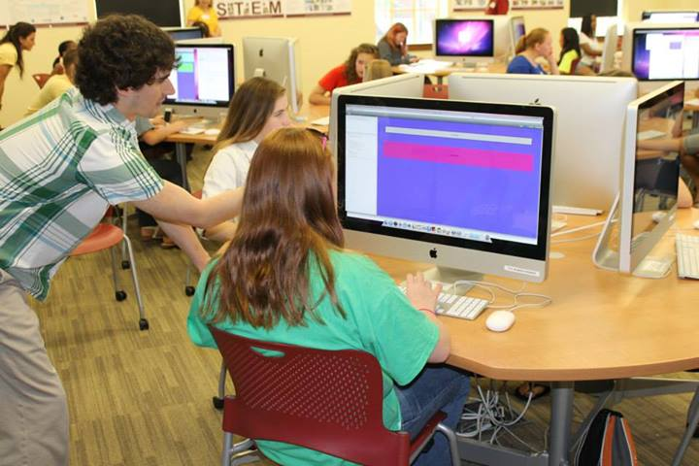

Slide 47
TSA
Work with established school programs that support TSA chapters
Work/Attend leadership conferences
Judge events at annual conference

Slide 48
TSA example
http://www.youtube.com/watch?v=Rrk-x9ajLp0&feature=c4-overview&list=UUD6C_m_oXgqjYSn4j8Z0LFg

Slide 49
Visit Middle Schools
Perfect time to get students thinking about potential fields of study/careers

Slide 50
Visit Middle Schools
Talk about STEM
Introduce to TSA
Show how technology is applicable
Provide resources to explore STEM/TSA

Slide 51
High School Outreach
Guide them into STEM programs

Slide 52
High School Visits
Hopefully the students have a thorough interest in STEM by now
Provide them with information on STEM careers
Talk to them about what they might want to study in order to achieve their goals

Slide 53
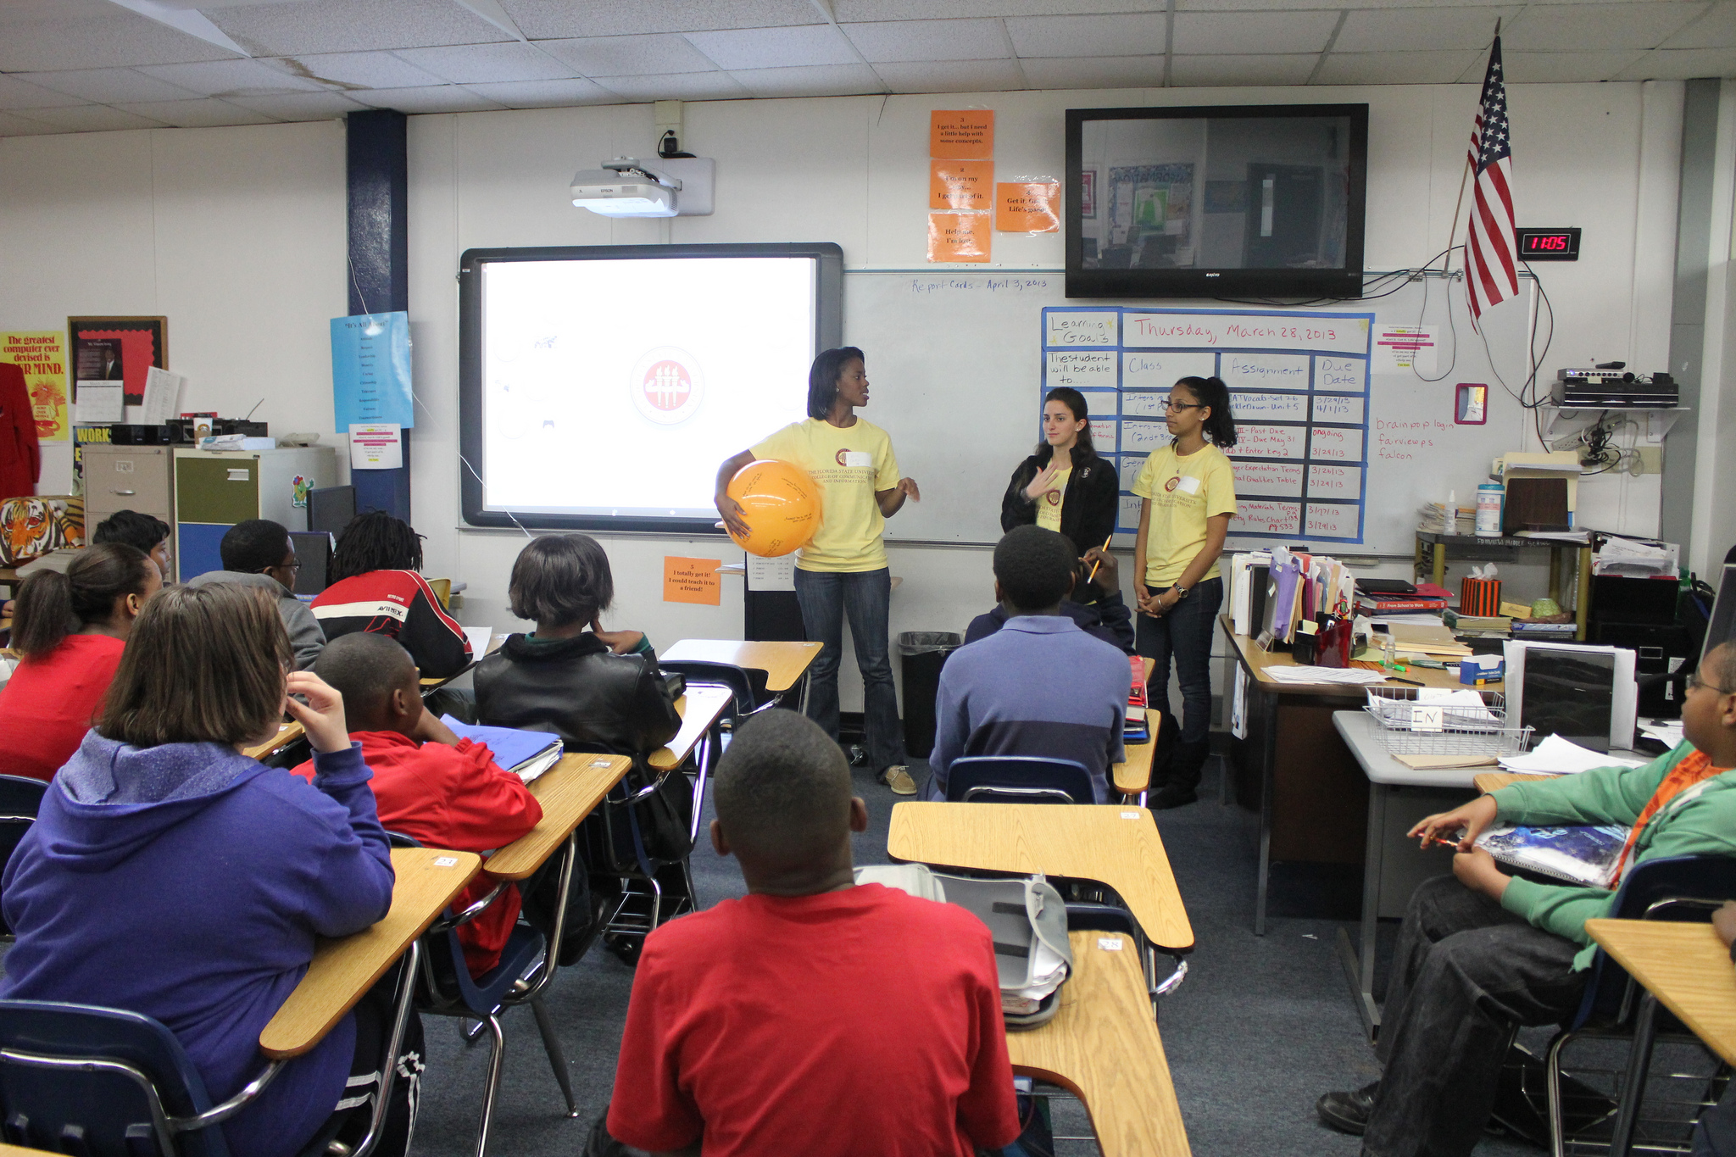

Slide 54
Hosting High Schools
Bring students to your school
Personalized tours
Educate about your program
Ask about career goals
Talk to STARS students about their experiences

Slide 55
Measuring Your Impact
Pre-survey
Post-survey
Ask for feedback

Slide 56
How to build Relationships

Slide 57
Build Relationships with Teachers at all Levels
Schedule meetings
Assist with curriculum
Advise on technical issues
Work with the county
Bring the resources with you
Use free software

Slide 58
Find the right STARS students
Friendly
Energetic
Passionate
Safe

Slide 59
Make the schools happy
Promote the schools you work with
TV/News/Web

Slide 60
Make the parents feel included
Greet parents
Allow to observe
Show student work at the end
Send things home with them
Give contact info
Open channel of communication – via email

Slide 61
Sustained Engagement
Leave students with resources to keep going
Extend an open line of communication
Follow up to thank them for their participation and remind them that you are there to help

Slide 62
Work around their schedule
School Schedule
Breaks
Holidays
FCAT
Testing
Be flexible and allow them to take the lead on when/where your events will be

Slide 63
Thank You
Questions?
For more info: starsalliance.fsu.edu

